Slide 1

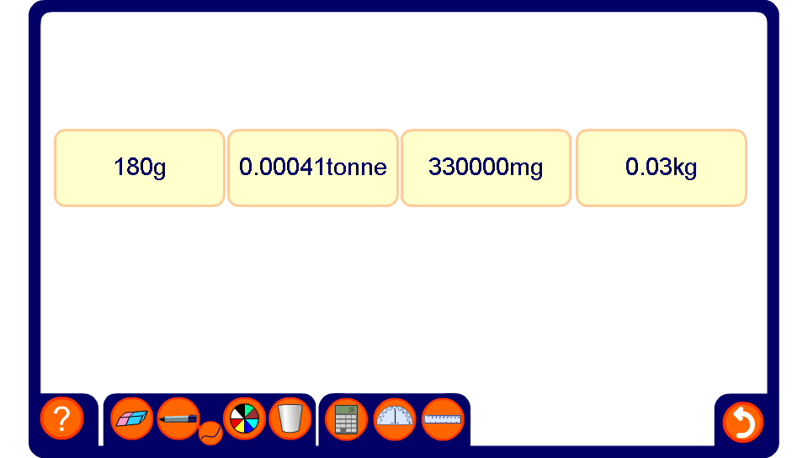


Ordering units
Notes:
Each of the amount shown could be converted to the same units to enable them to be ordered.

